Slide 1
Formation Flying
ET4399 Extra Project
Zhonggang Li
2021.7

Slide 2
Lin2016
The orthodox way of designing the weights:
a semi-definite program
realizability: N>=D+2, globally rigid
the simplest case: 4 nodes, 6 edges
e₃
Incidence matrix: links between nodes
Not working yet!!
1
e₂
3
e₁
e₅
e₆
Presumably, the weights should directly relate to the shape(only make sense), now try distance between nodes as weights
2
e₄
4
The generalized Laplacian
The problem is the weight design for a desired shape
08/01

Slide 3
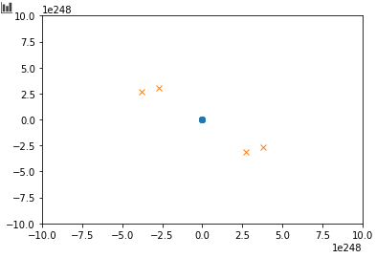
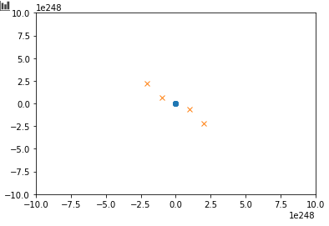
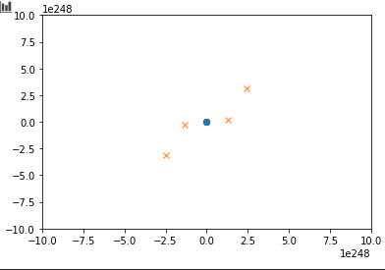
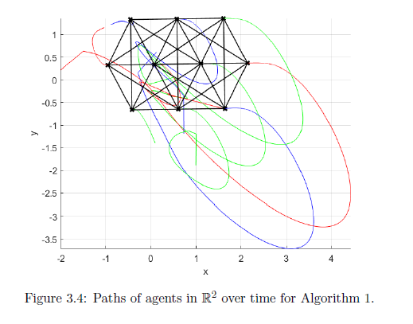
Lin2016
e₃
1
e₂
3
e₁
e₅
e₆
2
e₄
4
w = [1, sqrt(2),1,1, sqrt(2),1]
distance as weights
with random initial positions, the final shape seems to be of some shape
not the desired shape → weights not chosen as such
results for simulations don’t suggest rigidity (only allow translation and rotation), there is “stretch”
the values of the positions keeps growing (notice the axis). does it ever converge?
desired process
27, 44 in thesis
08/01

Slide 4
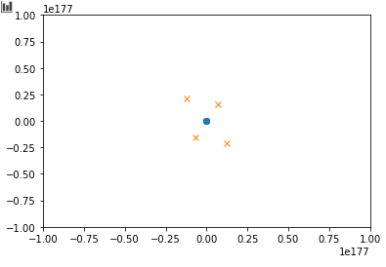
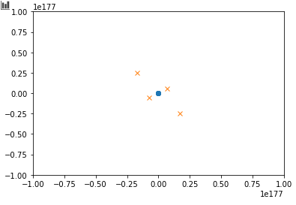
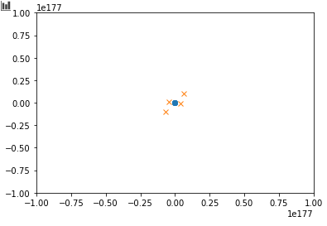
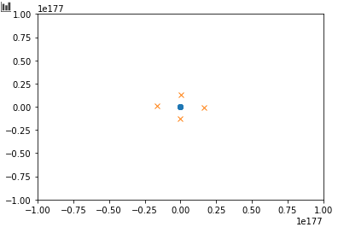
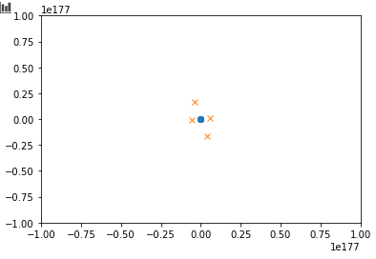
Lin2016
e₃
1
e₂
3
e₁
e₅
e₆
w = [0.707,1,0.707,0.707,1,0.707]
weight as inverted distance
2
e₄
4
As with the last weights, not rigid, not desired shape, large position values
more like the desired shape
08/01

Slide 5
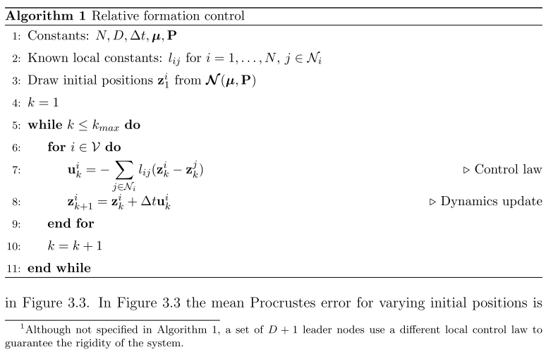
Lin2016
Direct subtraction: implying displacement-based?
q₁^{T}
q₂^{T}
e₃
1
e₂
3
e₁
e₅
e₆
2
e₄
4
Lin2016: affine transformation
We need it to be rigid: no scaling
What is the control law for the D+1 agents?
08/02

Slide 6
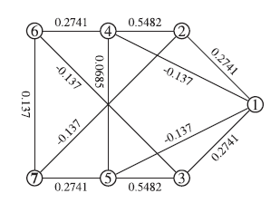
Zhao2018
Shape and weights
Coordinates of target configuration
Leader-follower split: 1-3 as leaders, rest are followers
Control law for leader: dz = u = -(p-z), using absolute coordinates to force into desired position
Control law for followers: Lin2016- affine transformation
A new method to acquire stress matrix
08/12

Slide 7
Zhao2018
If not implementing leader control law (all regarded as followers): affine transformation of the desired configuration. Not only are there rotation and translation, but also shearing, scaling.
This paper focuses on maneuvering the fleet with this formation. How to achieve this formation is more or less identical to Lin2016. But it provides some more perspectives into how certain conditions are made, what assumptions should be made to achieve this target config. A bonus is an alternative to constructing the stress matrix, and matrix-vector form of follower control law.
08/12

Slide 8
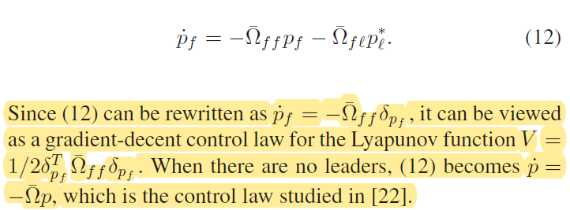

Zhao2018
e₃
1
e₂
3
e₁
Applying zhao2018 to the simplest target configuration:
e₅
e₆
2
e₄
4
Using 1-3 as leader and 4 as follower, stress matrix as acquired by method in Lin2016: MISSION ACCOMPLISHED
The optimization to get stress matrix (weight vector) is correctly implemented!
The individually implemented control law does not work, the minus sign should be plus.
NOW USE MATRIX-VECTOR FORM!!!
08/12

Slide 9
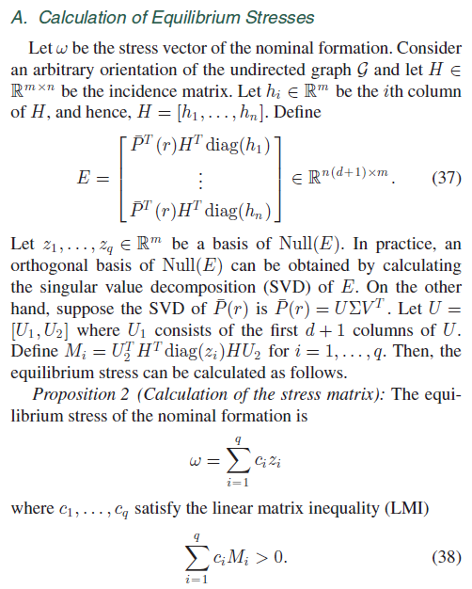
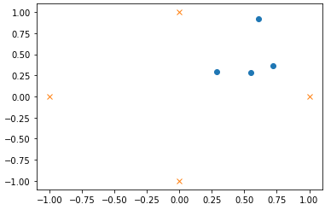
Zhao2018
LMI toolbox in MATLAB will suffice, but haven’t found a one for python
Regarding the LMI method for stress matrix solving:
Compromise solution:
If the null space of E is one-dimensional, then there is only one coefficient c₁ (+1 or -1), i.e., q=1.
We then determine the positive-definiteness of c₁M₁ by examining the sign of all EIGENVALUS (not singular values) of M₁.
If all eigenvalues are positive, just take w=z, otherwise w=-z as weight vector.
Then, as before, take L=Bdiag(w)B^{T} as stress matrix.
The definition of M (quadratic form) indicates that it’s positive/negative definite when H full-rank. Hence there won’t be cases where its eigenvalues have different signs. → they are either all positive, or all negative.
So far it also works for the square configuration
08/12

Slide 10
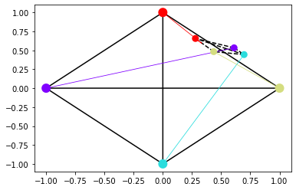
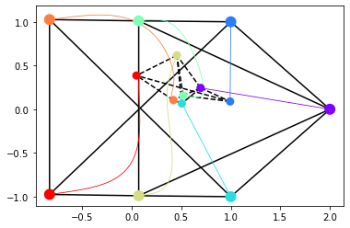
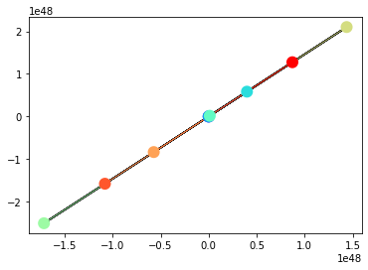
Extension from simplest configuration to more complex ones: control law all leader-follower matrix-vector form
square
pentagon
hexagon (Martijn)
e₆
e₇
8
e₂₁
5
e₉
2
3
6
4
2
e₂₉
e₂₈
e₂₀
e₈
e₆
e₉
e₁
e₁₉
e₁₈
e₇
e₆
e₃
e₁₃
e₁
e₂
4
e₂₅
e₁₄
e₂
1
e₁₀
e₂₆
e₁₅
e₃
e₅
e₅
e₁₂
1
10
7
e₁₆
4
1
e₁
e₄
e₂₇
e₁₇
e₄
2
e₈
e₂
e₅
e₁₁
e₂₂
e₁₀
e₃₀
e₂₃
e₁₁
7
e₄
5
e₃
3
9
e₂₄
6
e₁₂
3
LMI √
opt √
LMI √
opt ×
LMI multi-dimensional null-space
opt × (does not even converge)
08/15

Slide 11
8
e₂₁
5
e₉
2
e₂₉
e₂₈
e₂₀
e₈
e₁₉
e₁₈
e₇
e₆
e₁₃
e₁
e₂₅
e₁₄
e₂
10
e₂₆
7
e₁₅
4
e₃
1
e₂₇
e₁₆
e₁₇
e₄
e₅
e₂₂
e₁₀
e₃₀
e₂₃
e₁₁
9
e₂₄
6
e₁₂
3
08/15

Slide 12
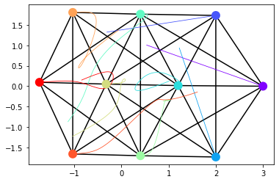
Hexagon
8
e₂₁
5
e₉
2
e₂₉
e₂₈
e₂₀
e₈
e₁₉
e₁₈
e₇
e₆
e₁₃
e₁
e₂₅
e₁₄
e₂
10
e₂₆
7
e₁₅
4
e₃
1
e₂₇
e₁₆
e₁₇
e₄
e₅
e₂₂
e₁₀
e₃₀
e₂₃
e₁₁
9
e₂₄
6
e₁₂
3
Implementing LMI with MATLAB LMI toolbox and copy the solution to python
LMI Python multi-dimensional null-space
LMI MATLAB √
opt × (does not even converge)
Compare these two options: convergence
See also how robust the formation is (how quickly they can be in formation again)
TO DO NEXT:
Implement LMI in python (recommended tools?)
Fix opt
Write report on this control section
Advance to signal processing section
08/18

Slide 13
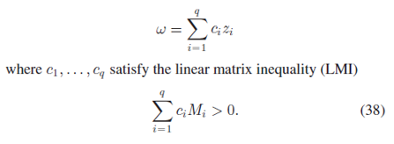
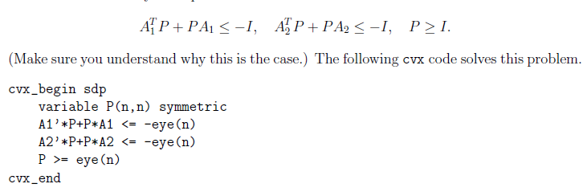
Implement LMI in python (recommended tools?)
No proper tool to implement LMI directly → turn to a opt problem
Boyd’s note: just minimize(0), it solves a feasibility problem
Gives all zeros, could be
Wrong implementation
Requires positive definite, but only semidefinite allowed in cvx
Fix opt
No luck
Write report on this control section
Advance to signal processing section

Slide 14
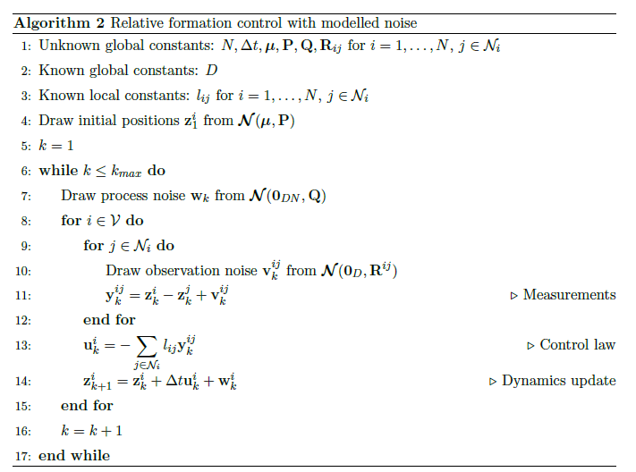

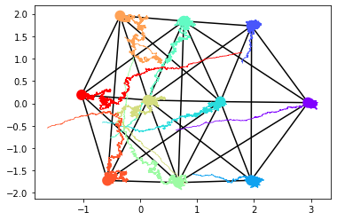
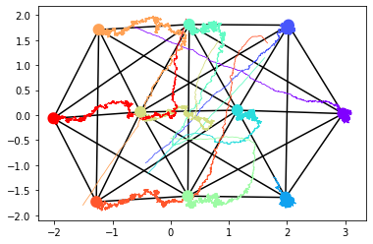
Adding noise model
Measurement noise:
defined on edges z_{ij}
Wouldn’t it make more sense that the noise is modeled at nodes? Since the measurements are eventually taken by each agent no matter how we stress relativity.
Critical problem, what’s the measurement noise for the leaders?
Currently assume none
Think about CRBs
08/22

Slide 15
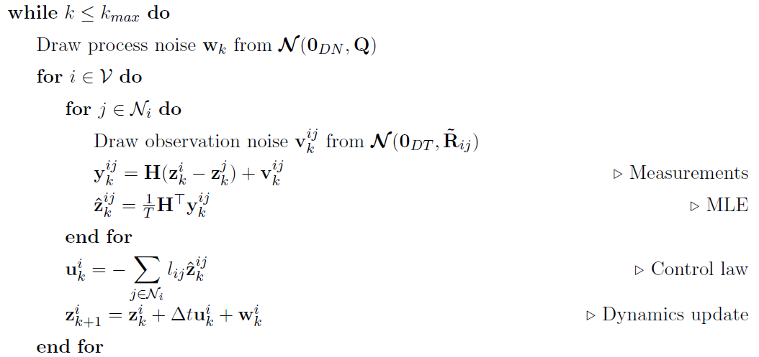
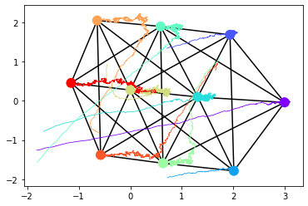
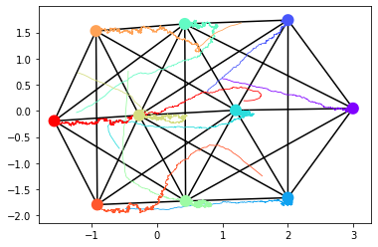
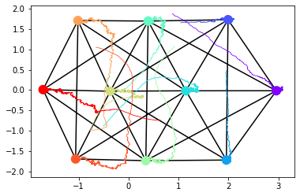
Implementing MLE
Issues:
extremely slow:
Previously compact matrix-vector implementation
there are 4 nested for loops in the algorithm (including one building the measurement noise
t=15, dt=0.01
T=1
T=10
T=100
18min
Not yet on the Procrustes errors
08/24

